Slide 1


CYBERSECURITY BRIEFING 2026
Retail Sector Cyber Risk: Threats, Impact & Resilience
The combination of high financial reward, vast repositories of monetizable PII, and the critical necessity for uninterrupted operations renders the retail industry a highly preferred and continuously targeted hunting ground for sophisticated cyber threat actors.

Slide 2
Key Threats & Top Cyber Attack Vectors
Retail's sprawling digital and physical footprint creates a uniquely fragmented attack surface. From legacy POS terminals to API-heavy e-commerce platforms and deeply interconnected supply chains, threat actors exploit architectural weaknesses at every layer.
POS Malware
E-Commerce Exploits
Supply Chain Compromise
RAM-scraping malware targets unencrypted magnetic stripe data on legacy systems across dispersed locations with inconsistent physical security.
Misconfigured APIs, credential stuffing, and massive DDoS attacks overwhelm platforms during peak seasons, causing immediate revenue cessation.
Vendor email compromise and zero-day exploits in unmonitored vendor portals provide lateral access into core retail networks for ransomware deployment.
Retail-Specific Vulnerability Landscape
Domain
Architectural Weakness
Business & Systemic Impact
POS Systems
Heterogeneous devices, legacy OS, dispersed locations, inconsistent physical security
PAN exposure, PCI-DSS fines, reputational damage, card replacement costs
E-Commerce
Heavy API reliance, fast-tracked rollouts bypassing secure-by-design principles
Revenue loss, cart abandonment, GDPR penalties, erosion of digital trust
Supply Chains
Fragmented attack surface via 3PL providers, cloud infrastructure, franchisee systems
Cascading failures, stockouts, operational paralysis, financial contagion to banking networks

Slide 3
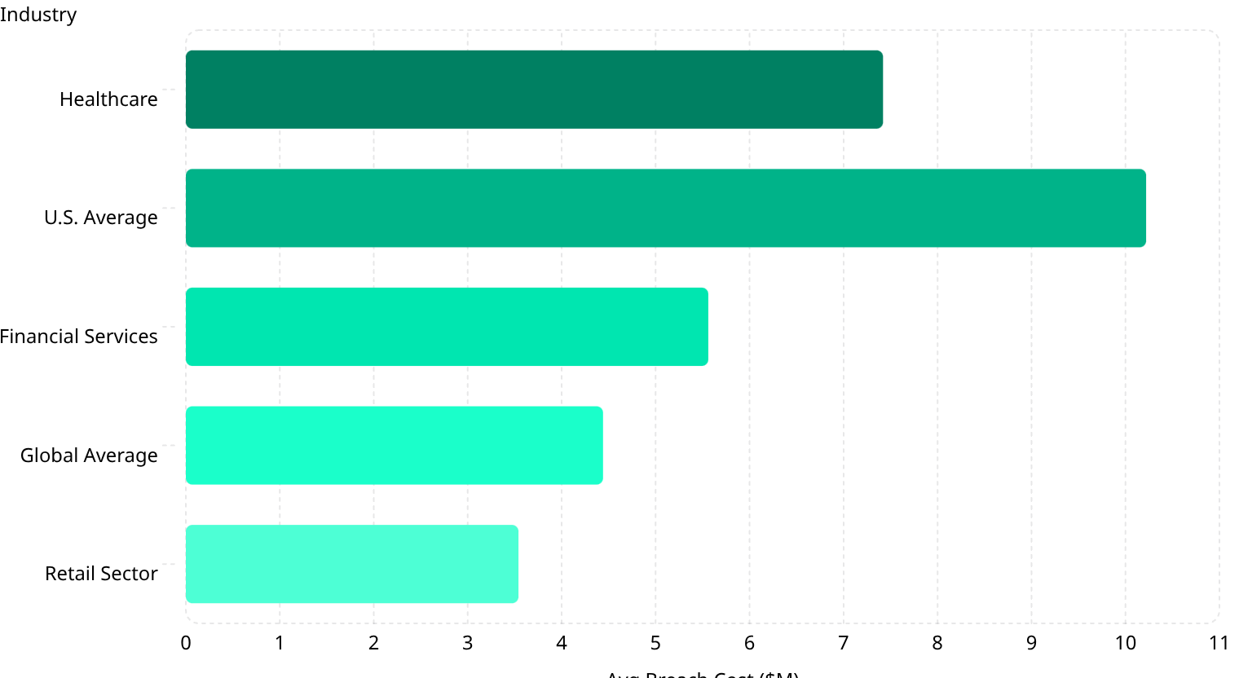
Financial Impact of Cyber Incidents in Retail
What was once a localized IT expense has evolved into a material financial event capable of eroding enterprise value and threatening corporate solvency. In early 2026, the global average cost of a data breach stands at $4.44 million, while U.S. breaches have surged to a record $10.22 million per incident.
Key Financial Metrics
Retail vs. All Industries
$3.54M
$48B
Retail Breach Cost
E-Commerce Fraud
Up from $3.48M, with a 17% YoY increase
Projected global extraction from the sector
$343B
197
Payment Fraud
Days to Identify
Cumulative cost 2023–2027
Average breach identification time in retail
87% of consumers will permanently leave a brand after a data mishandling incident. 76% of organizations need 100+ days to restore operations post-breach.
Cost Breakdown by Category
1
2
Lost Business & Downtime — $1.47M (33.1%)
Detection & Escalation — $1.47M (33.1%)
Direct revenue loss from e-commerce outages, cart abandonment, mass customer attrition, and exorbitant marketing costs to replace churned demographics. Exponentially amplified during peak seasons.
Specialized forensic investigation, third-party audits, crisis management activation, and premium-priced emergency incident response retainers to halt lateral network movement.
3
4
Notification — $1.31M (29.5%)
Legal & Remediation — $1.25M (28.1%)
Mandatory regulatory and consumer communications, legal drafting costs, credit monitoring agency coordination, and staffing of inbound consumer crisis call centers.
Post-breach legal defense, consumer class-action settlements, PR crisis management, and unbudgeted capital expenditure to replace compromised hardware and fortify network architecture.

Slide 4
Case Study: 2025 UK Retail Cyber Attack
The 2025 attack on major UK retailers including M&S and Harrods fundamentally altered how corporate risk executives assess enterprise security. Attackers exploited third-party helpdesk staff via social engineering, obtaining privileged credentials to pivot into core infrastructure — resulting in a £388.5 million drop in pre-tax profits.
Operational Impact Timeline
Days 1–14: Reconnaissance
1
Covert. Targeted social engineering of third-party helpdesk staff to obtain privileged admin credentials. No operational impact observed.
2
Days 15–21: Lateral Movement
Covert. Pivot from vendor network into core M&S/Harrods infrastructure. Data silently exfiltrated using legitimate credentials, evading internal security tools.
Day 22: Detonation
3
Catastrophic failure. Ransomware executed across networks. E-commerce crashes, ERP locks, POS degrades. Extortion demands issued with data disclosure threats.
4
Days 23–30: Containment
Severe disruption. Digital operations halted. Emergency IR firms deployed. Manual paper-based workarounds attempted in stores, causing massive customer friction.
Days 31–90+: Recovery
5
Degraded operations. Slow restoration from immutable backups. Prolonged delays in supply chain logistics, inventory restocking, and vendor payments.
6
Month 6: Financial Fallout
Market shock. Mandatory disclosure of £388.5M profit drop to shareholders and regulators, triggering immediate downward equity valuation pressure.
Three Paradigm-Shifting Lessons
Identity Is the New Perimeter
Systemic Concentration Risk
DORA Is a Survival Imperative
Attackers hacked human psychology, not firewalls. Traditional perimeter defenses are ineffective against socially engineered credentials. Security must pivot to continuous identity verification and Zero Trust.
Reliance on a single third-party provider for core IT creates a massive single point of failure. Interconnected supplier ecosystems leave retailers deeply and dangerously exposed.
Organizations are legally responsible for vendor cyber resilience. Vendor oversight requires continuous real-time threat intelligence, auditing, and stringent contractual security mandates — not annual questionnaires.

Slide 5
Mitigation Strategies & Implementation Framework
Retail organizations must aggressively transition from reactive, perimeter-based security to proactive, risk-based operational resilience. The optimal defense requires a holistic synthesis of Zero Trust principles, AI-driven automation, and rigorous regulatory adherence.
Strategy Effectiveness & Investment Metrics
Strategy
Technical Focus
Budget %
Annual Cost
Effectiveness & ROI
Zero Trust Architecture
IAM, Phishing-resistant MFA, Micro-segmentation
35–55%
$15K–$45K+
76% reduction in breaches, 89% decrease in MTTD. Prevents $2M+ in uncontained losses.
AI-Driven XDR
Automated containment, predictive threat intel, advanced SIEM
25–40%
$8K–$28K+
Reduces breach lifecycle by 80 days. Saves $1.9M–$2.2M per breach.
DORA / TPRM Compliance
Continuous vendor monitoring, live RoI software, pen testing
10–15%
$5K–$18K+
Closes supply chain vulnerabilities. Avoids $5M–$8M third-party breach scenarios.
Employee Training
Phishing simulations, anti-social engineering protocols
8–12%
$2.5K–$8K+
Reduces phishing click rates to <8%. Prevents ~$150K per avoided BEC incident.
Return on Security Investment (ROSI)
Retail-Specific Security Framework
Cybersecurity ROI measures avoidance of catastrophic loss, not direct revenue generation. Using standard actuarial risk modeling:
01
ROSI = (ALEbaseline × M − C) / C
DORA Operationalization
Applied to retail: this calculation yields an immense ROI of 414%, demonstrating that strategic cybersecurity investments deliver exceptionally high capital efficiency.
Board-approved resilience plans, threat-led penetration testing, stringent incident reporting
02
NIS2 Alignment (Sep 2026)
ECCF certification shifts from voluntary to mandatory compliance instrument
03
CRA Preparedness (Late 2026)
Mandatory reporting of exploited IoT vulnerabilities, enforceable from Sep 11, 2026

Slide 6




Building Cyber Resilience for Retail 2026
By adopting a deeply integrated, mathematically risk-quantified approach, retail organizations and their financial banking partners can navigate the asymmetric threat landscape of 2026 — ensuring operational continuity, protecting brand equity, and satisfying the most stringent EU regulatory mandates.
Identity-First Security
AI-Powered Defense
Zero Trust architecture with continuous verification replaces obsolete perimeter defenses
Automated detection and containment reduces breach lifecycle by 80 days
Vendor Resilience
Regulatory Alignment
Continuous third-party monitoring avoids $5M–$8M supply chain breach scenarios
DORA, NIS2, and CRA compliance as foundational business survival imperatives
87% of consumers will permanently leave a brand after a data breach. With a 414% ROSI, strategic cybersecurity investment is not a cost — it is the highest-yield capital allocation available to retail enterprises.

